Slide 1

Transfer Learning Based Hybrid Quantum Neural Network Model for Surface Anomaly Detection
Sounak Bhowmik and Himanshu Thapliyal
VLSI Emerging Design and Nano Things Security Lab (VEDANTS - LAB)
Dept. of Electrical Engineering and Computer Science,
University of Tennessee, Knoxville, US
Email: sbhowmi2@vols.utk.edu, hthapliyal@utk.edu
VEDANTS Lab
02-07-2024

Slide 2

Abstract of the work
Problem Statement
The rapid increase in the volume of data increased the complexity of the large deep learning models, making them more time and resource intensive for training than ever.
What we proposed
We applied quantum transfer learning (QTL) to reduce the total number of parameters of the model without affecting their performance.
VEDANTS Lab

Slide 3
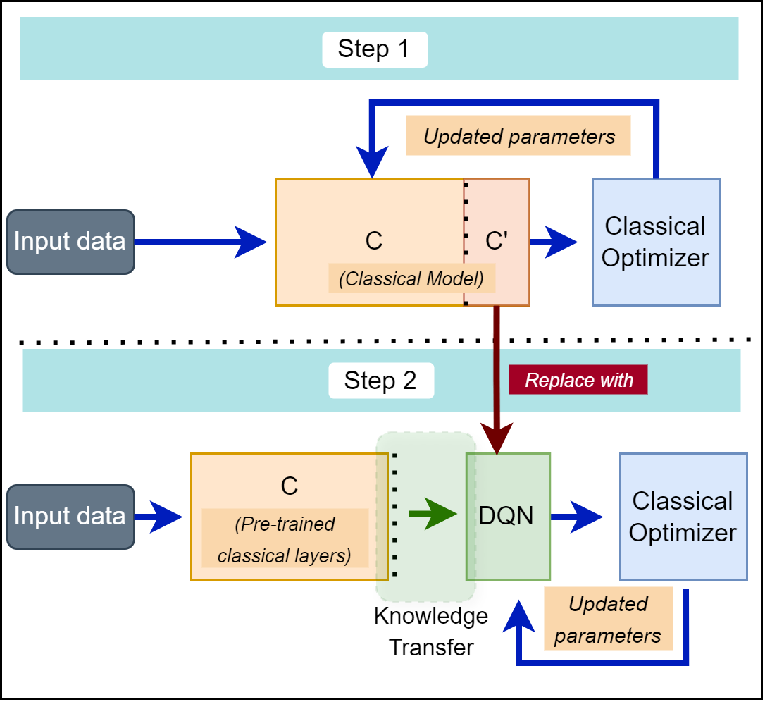
What is Quantum Transfer Learning (QTL)?
A QML method that combines the power of classical machine learning and quantum computing.
A benchmarked classical model.
Replacing layers with a Variational Quantum Circuit.
Keep the initial layers fixed and train the VQC.
VEDANTS Lab

Slide 4
Why QTL?
Superposition, entanglement - phenomenons that can be utilised only in quantum domain.
We keep the best abilities of both the classical and quantum computing.
Quantum circuits are light and flexible.
Reduce the parameter volume of a model using QTL.
Response time of a trained hybrid classical quantum model will be less with the emergence of error-free quantum computers.
VEDANTS Lab

Slide 5
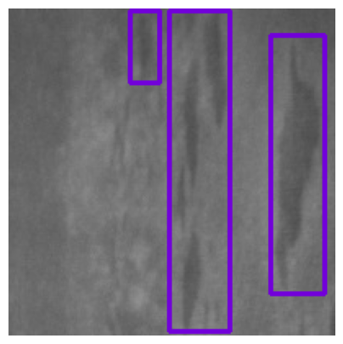
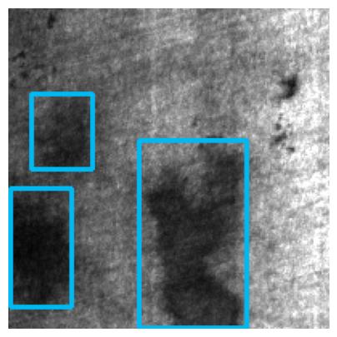
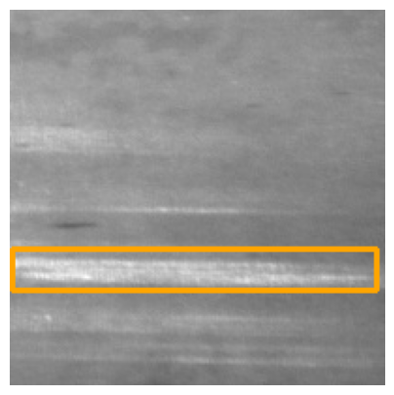
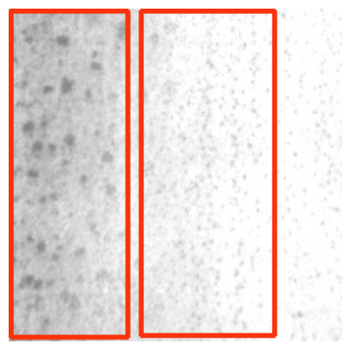
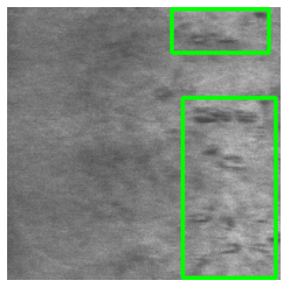
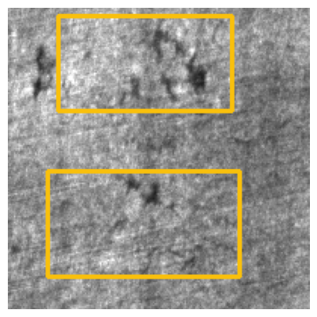
The Experiment
Binary classification problem on surface anomaly detection.
Objective: To show that quantum transfer learning can bring down the total number of parameters without affecting the models performance.
Three classical models to benchmark their performance.
Applied quantum transfer learning that reduces the total number of parameters and compare their performances.
Inclusion
Patches
Scratches
Pitted surface
Rolled-in scale
Crazing
VEDANTS Lab
NEU-DET [1] surface anomaly detection dataset
[1] Song, Kechen, and Yunhui Yan. "A noise robust method based on completed local binary patterns for hot-rolled steel strip surface defects." Applied Surface Science 285 (2013): 858-864.

Slide 6
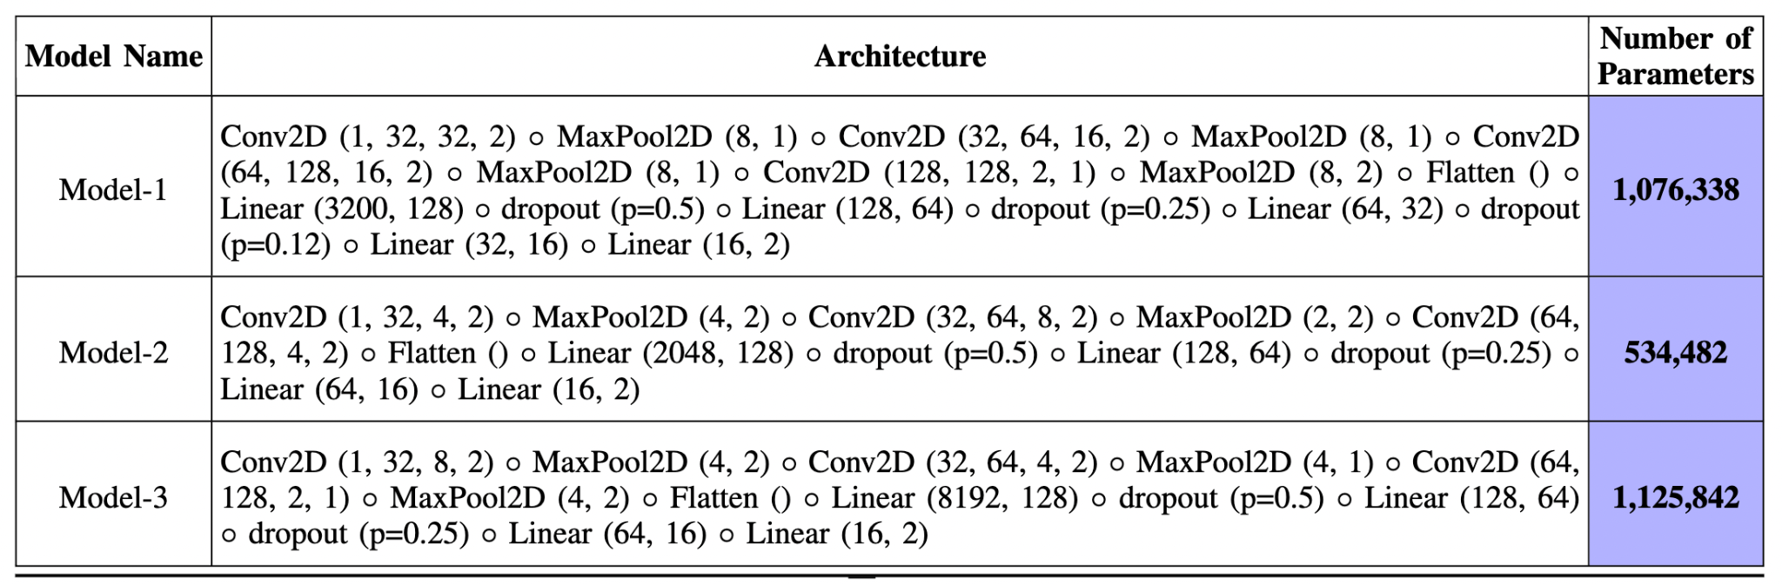
Design of Classical benchmark models
relu()
relu()
softmax()
Input
General architecture
Flatten
Dense + dropout
Dense + dropout
Convolution
Max Pool
Models used in this experiment had different design and total parameters.
All are based on Le-Net based architecture.
VEDANTS Lab

Slide 7
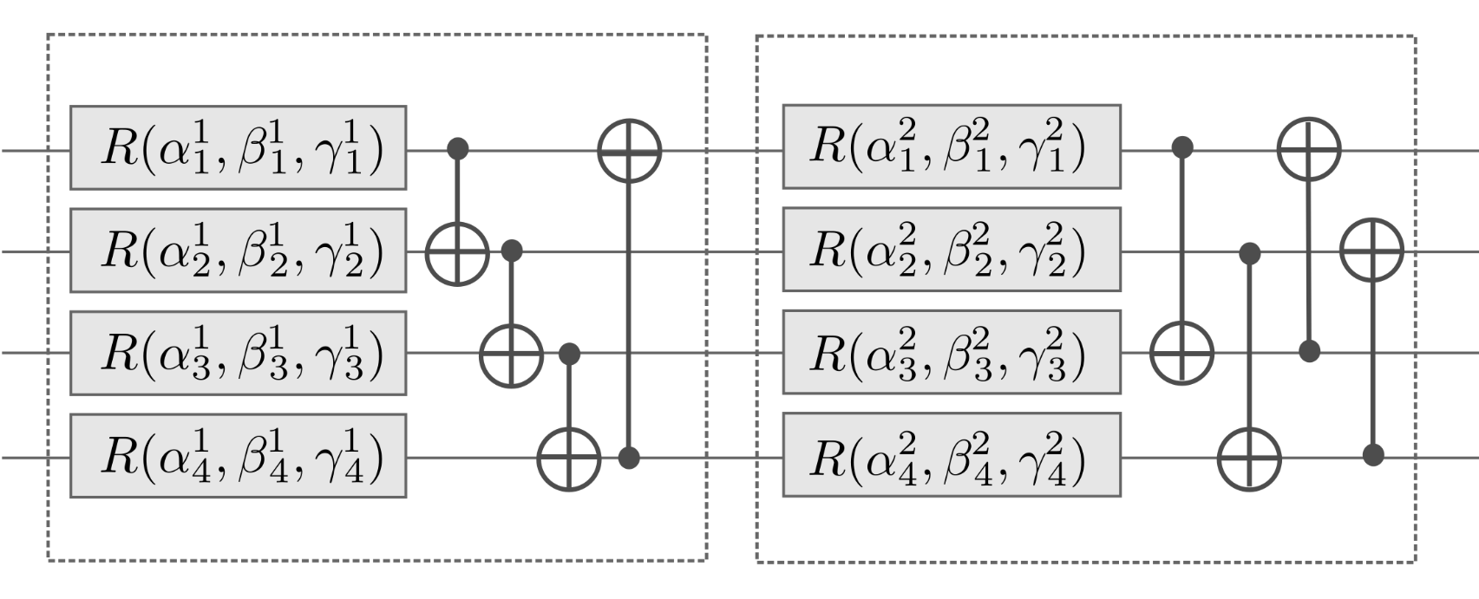
The Design
Models Used in this experiment
Dressed Quantum Network (DQN)
(A)
(B)
Encoding
Weights update
Measure
Classical Layers
(Fixed Weights)
Input
Data
pre-net
post-net
Labels
VQC
Extracted features
Encoded Features (angle embedding)
Predictions
#Layers replaced
2
3
All (4-5)
Classical Model-1
HM-1_CM-1
HM-2_CM-1
HM-3_CM-1
VEDANTS Lab
Classical Model-2
HM-2_CM-2
HM-3_CM-2
Base Models
HM-1_CM-2
Classical Model-3
HM-1_CM-3
HM-2_CM-3
HM-3_CM-3

Slide 8
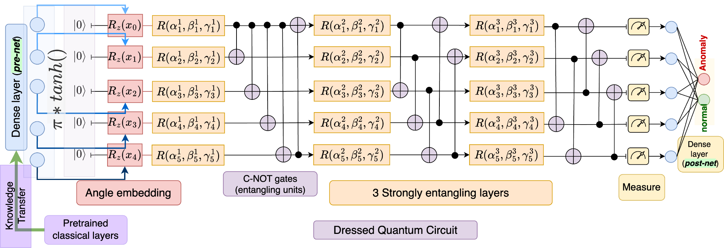
The Design of the DQN
VEDANTS Lab

Slide 9
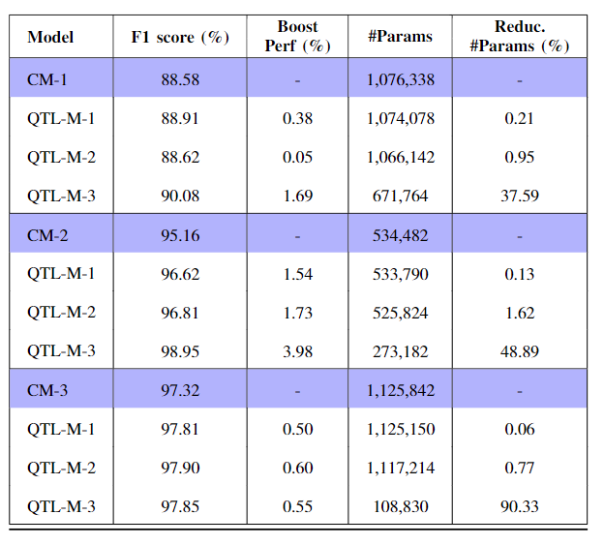
Results
Same training and validation set used for training all the models.
6-fold cross validation for each model and then took the average.
Random initialization ensures exhaustive search over the parameter space (no local minima problem).
QTL has significantly reduced the number of parameters without affecting their performance.
VEDANTS Lab

Slide 10
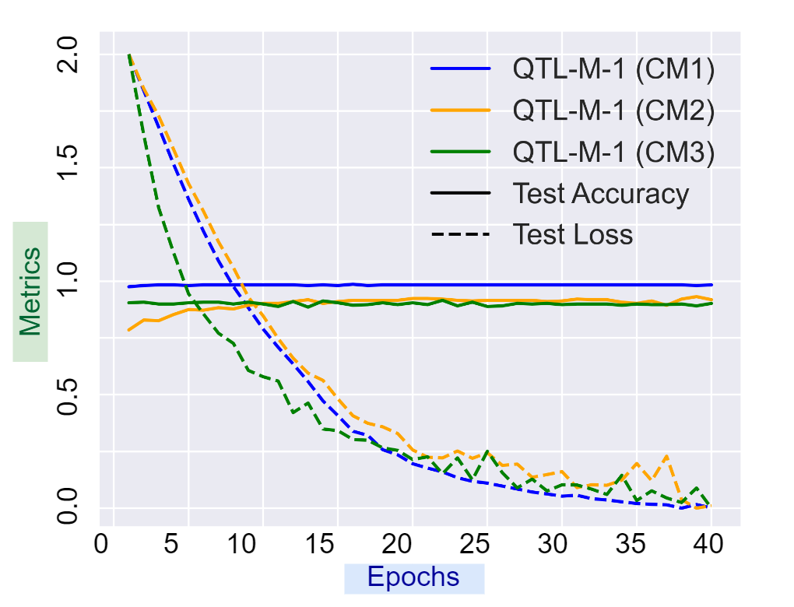
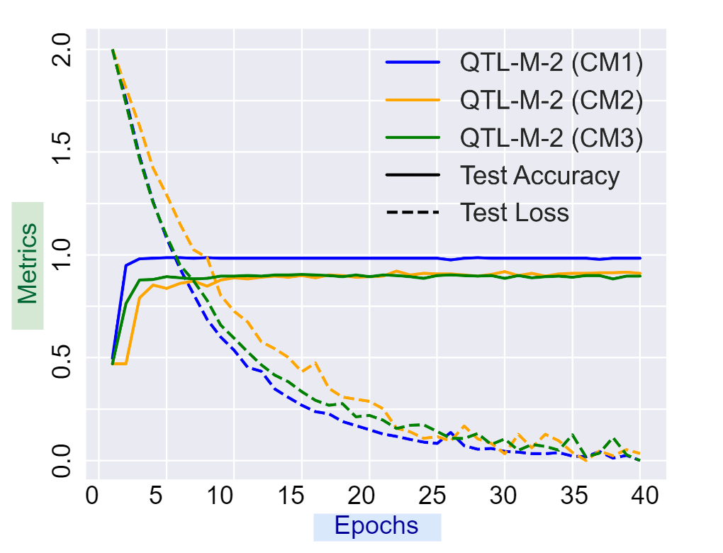
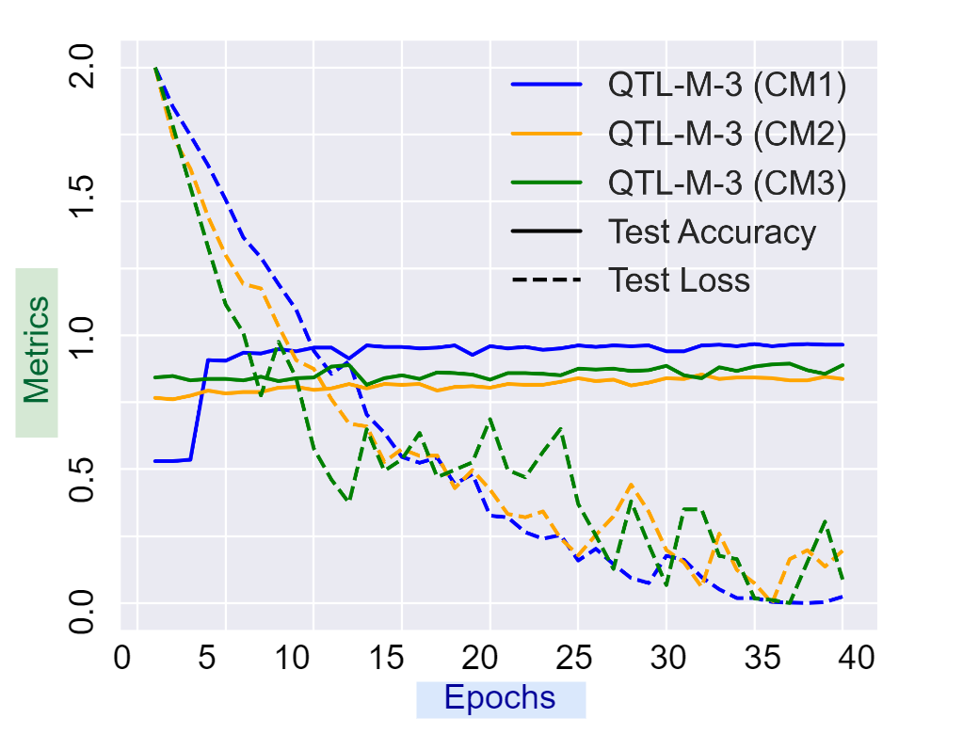
Convergence curves of the QTL-based models
Jitters in the curve
VEDANTS Lab

Slide 11
Hurdles in Practical Use Cases
Available quantum computers are noisy, unfit for gaining any practical benefit.
Need of general purpose quantum computers that can serve on-demand computational requirements.
Using large number of qubits lead to rise in the complexity of the circuit.
VEDANTS Lab

Slide 12
Conclusion
3 versions of QTL-based models → reduced the total number of parameters significantly → Performance is not compromised.
Used the feature extraction capability of the classical convolution and quantum advantages of the VQC together efficiently.
More sustainability and flexibility.
Efficient hybrid approaches are the best way to utilize the power of both the classical machine learning and quantum computation.
VEDANTS Lab

Slide 13
Future work
More efficient design of VQCs.
Quantum convolutional models.
Noise-resilient approaches.
Using simulators with noise models as well as quantum machines to test the existing and new designs.
VEDANTS Lab

Slide 14
Thank You!
VEDANTS Lab

